Slide 1
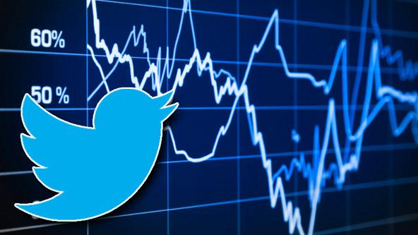
Analyzing Unstructured Data
for Finance
a.k.a. Sentiment Analysis of Twitter to predict the rise and fall of stock prices
Josephine M. Ho
Github: josephinemho
Notes:
For my DS project, I decided to look at unstructured data (aka “text”) to predict the rise and fall of stock prices.
Usually when we talk about financial data, the first thing that comes to mind is pricing data (smoothing/ARIMA). Traditionally, it involves a lot of information about a company’s performance in numbers, you have traditional providers like Bloomberg and Reuters, which offer an abundance of pricing data related to specific companies, and techniques for studying numeric, well-structured data are very well-developed.
On the other hand, using unstructured (“text”) data in finance is still a very green area. There are some experts who are looking at things like annual reports, broker research, investor relations presentations, 3rd party research and news and press releases. But it’s still an emerging field.

Slide 2
Why?
Value
Major financial firms like JP Morgan, Goldman Sachs, Morgan Stanley, CitiGroup hire quantitative traders for years to build predictive models on past market data.
About 70% of all orders on Wall Street are now placed by software, run by Machine Learning experts.
Objective
Build an algorithm that can predict whether S&P 500 stocks go up/down based on correlations with raw, unstructured text data extracted from Twitter.
Approach
Minimal data cleaning (our benchmark) → run it through a couple models → explore data and results → iterate (more data cleaning) → repeat
Notes:
Passive income
Curious about the state of our markets and economy
Psychologists who want to study sentiment
Traders who want a competitive edge by looking unconventional sources of data
A strong algorithm in finance is one that gets new information that other people don’t have – that’s what gives you an edge.

Slide 3
The Challenge
Natural Language Processing (NLP) == hard
Turn words into math (vectors)
Issues with sparse matrices
So many ways you can dissect the data, you really have to iterate a lot more to optimize your model
Twitter data is messy (has a lot of noise)
The quality of the source of your tweets (credibility)
You can never get a correlation/predictive score of 100%
Take the tweets of 30 thought leaders and news outlets to predict the S&P 500 index
Notes:
Natural Language Processing (NLP) == hard
This is one of the reasons why this field is still quite underdeveloped, considering it’s such a lucrative industry.
--------
Collected eight years of stock data
Collected tweets from 30 hand-picked accounts
Find traders with more than 5k followers and who posts actionable stock-alert tweets
Look at his/her last tweet and make sure it was posted within the hour to ensure he/she tweets regularly and often
Data size
Tweets (94,856, 6)
Stocks (2013, 10)
After data cleaning: (77,258, 6)

Slide 4
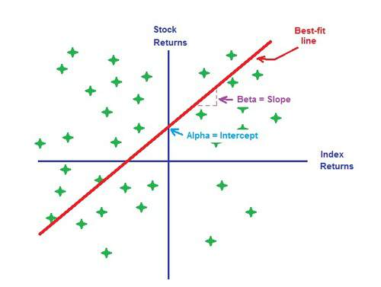
What will get you alpha?
Notes:
So the problem with using traditional data sources is that you’re not the only person who has these ideas. If a lot of people with similar ideas implement very similar algorithms and use similar data sets, then these algorithms are going to perform the way and you’ll have very similar outcomes to your competitors.
This is a problem because in finance, you want to generate alpha, which is the surplus in the market. And your competitors have the same intentions as you, so if everyone uses similar techniques on similar sources of data, it becomes very difficult to reach your alpha anymore. This is the holy grail of every financial company.
That’s why it’s important to get other, more innovative sources of data.
There are actually companies who prefer to build their dataset in-house so their competition doesn’t have access to it.
To reach alpha, you have to build a “smarter” algorithm and get a bigger share of the surplus than your competitors:
A more novel algorithm
A faster algorithm
Have very interesting ideas on how to implement algorithm
You have a unique dataset that no one else has, which has useful information where you can pull signal from

Slide 5
Why Twitter?
Measure Sentiment
Twitter is a freely available psychology tool, where people around the world post thousands of reactions and opinions of every second of every day. It's like one big psychological database that's constantly being updated, and we can use it to analyze millions of text snippets with the power of Machine Learning.
Real-time
Market opportunities happen in real time; and people who tweet about them can deliver the information faster than the news media can. Stocks are constantly changing in price, and tweets of comments and opinions can act as timely alerts.
Notes:
I choose Twitter.
Measure sentiment (stocks are influenced by how people feel)
Real-time (stock trades are made fast, and being quick makes you a good trader)
When an event happens, you want to know that information before your competitors do. Their sources might be Bloomberg or Reuters, but social media is real-time. Usually information in the news appears later than social media.

Slide 6
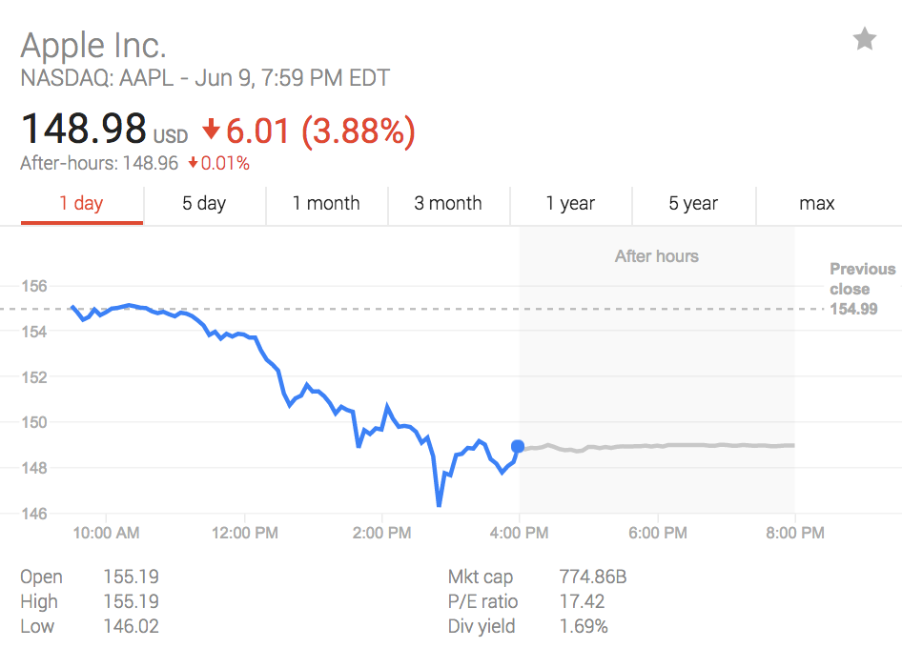
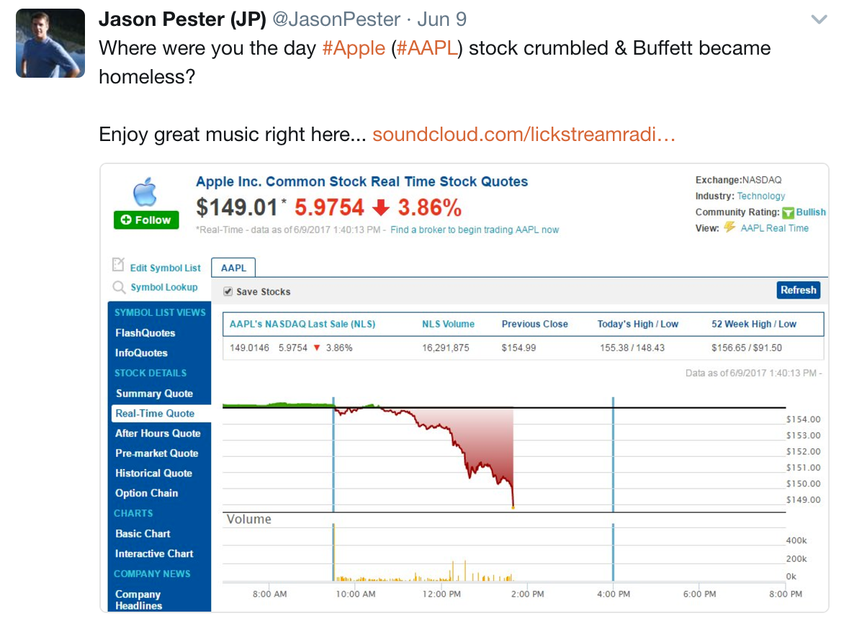
Notes:
This is what traditional data sources look like, which already comes in a really nice format. They’re numeric, so it’s pretty straight forward to feed them into an algorithm as input data and come up with a model.

Slide 7
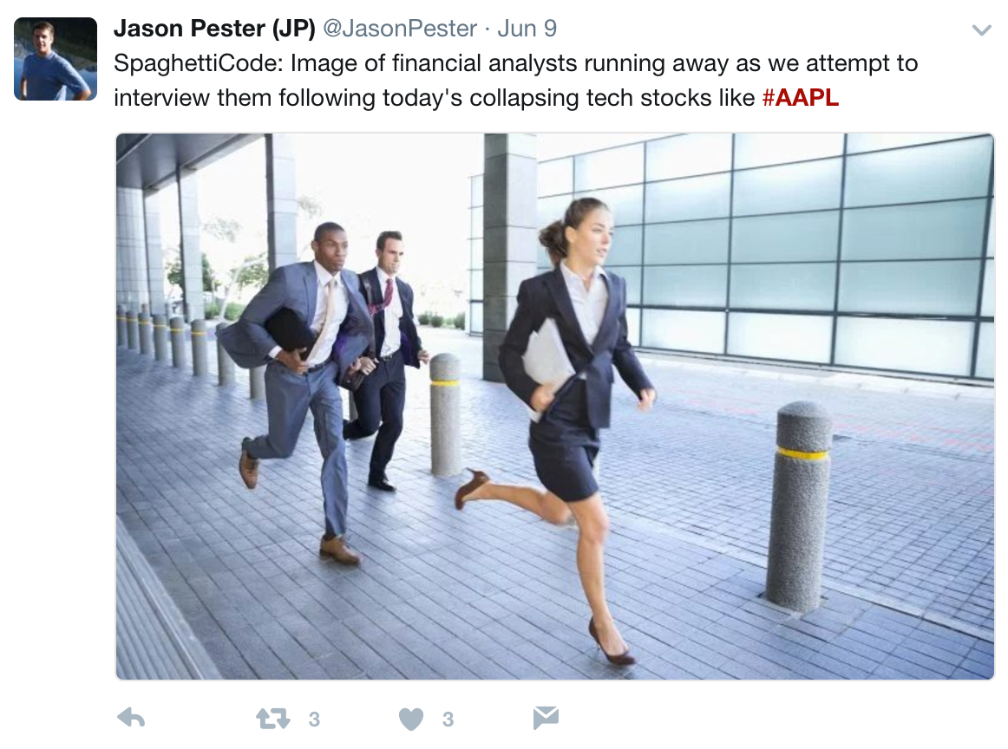
Notes:
However, there’s a lot of unstructured data that doesn’t come in such a nice format – annual reports, press releases.
This is what stock data looks like now.
It’s much more work and it’s all text-based. This untapped resource needs a lot more pre-processing work done to it to reach the quality of its counterpart – the numeric data that we have come to know and refine so well.

Slide 8
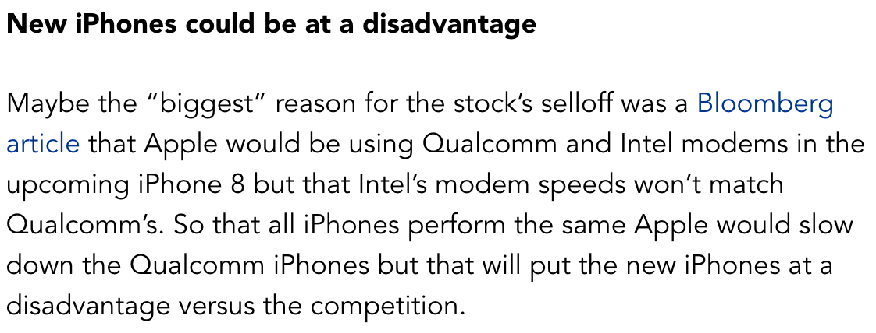
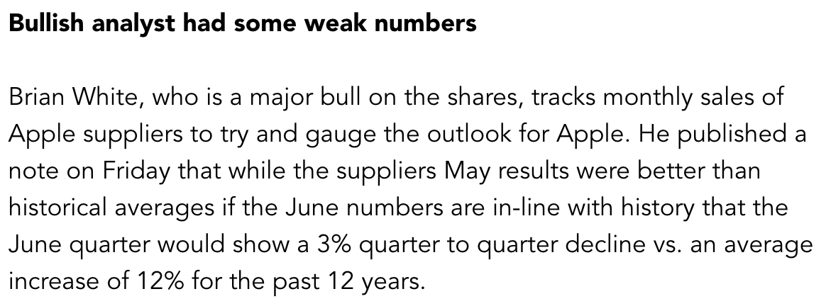
What happened to AAPL on June 9, 2017?
Reasons Apple’s Shares Took a Drubbing (Forbes article)
SENTIMENT
Notes:
Tweets (major source of news) can capture public sentiment and correlate (or possibly cause) changes in the stock market, like Apple.

Slide 9
Approach
Setup & collection of tweets
Pre-processing & text cleaning
Get target data (S&P 500)
Combine features and target
Transform target data (label encode)
Model Selection
Tuning Hyperparameters
Iterate!
It takes many iterations to fine-tune your model
Removing noisy words (feature selection)
Notes:
# Part 1 -- Setup and Collection of Tweets
Pull Tweets from the Twitter API (using Tweepy) and collect **tweets from 30 thought leaders and news outlets** using MongoDB as a task manager (manual distributed processing).
# Part 2 -- Pre-Processing and Text Cleaning
Next we're going to do some basic pre-processing, like converting the text to lower case and deleting URLs. We don't need to remove stopwords such as "the" and "a", which will be done when we pass our data through a NLTK model later.
# Part 3 -- Get Target Data (S&P 500)
Get our target data (the S&P 500 index) from the Yahoo Finance website and perform calculations. We want to look at the Adj Close price to determine whether stocks went up/down/neutral compared to the previous day. This will be a **classification model** and we will set our threshold of up/down/neutral to a change of 0.01%.
# Part 4 -- Combine Features and Target
Since our feature data (tweets) and target data (stocks) are pulled from different sources and have different numbers of rows and columns, we will need to do some cleaning to make sure our X's and y's share the same number of rows. This is important for when we feed our data into models.
# Part 5 -- Transform Target Data (SP500)
LabelEncode our y's so we can have more flexibility running it through models (e.g. LogisticRegression).
# Part 6 -- Model Selection
Using pipelines to find the best predictive model for our data.

Slide 10
Let’s dive into the data!

Slide 11
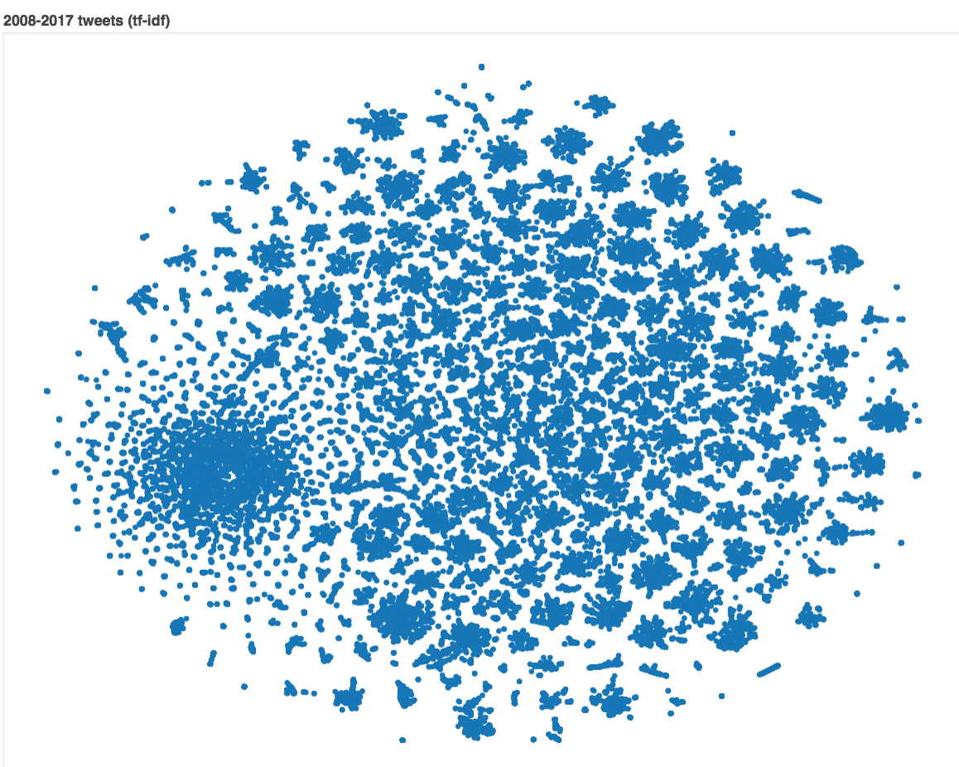
Notes:
What are you trying to say?
What questions do they have?
What answers do you find for them?
What other questions does it inspire?
What conversations will result?
The point is that your viewers should take something away from the time they spend with your visualization.

Slide 12
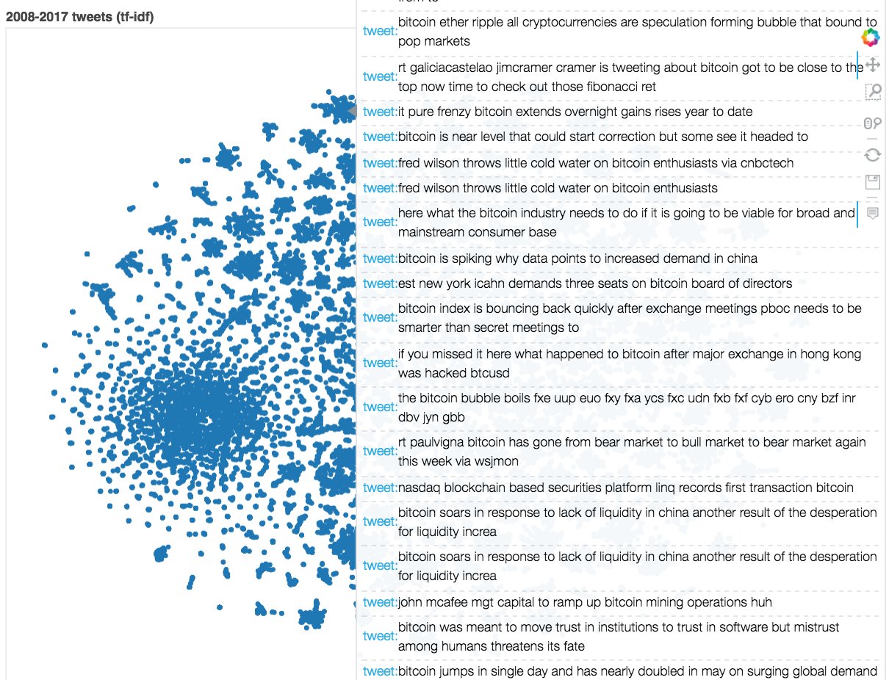
Notes:
What are you trying to say?
What questions do they have?
What answers do you find for them?
What other questions does it inspire?
What conversations will result?
The point is that your viewers should take something away from the time they spend with your visualization.

Slide 13
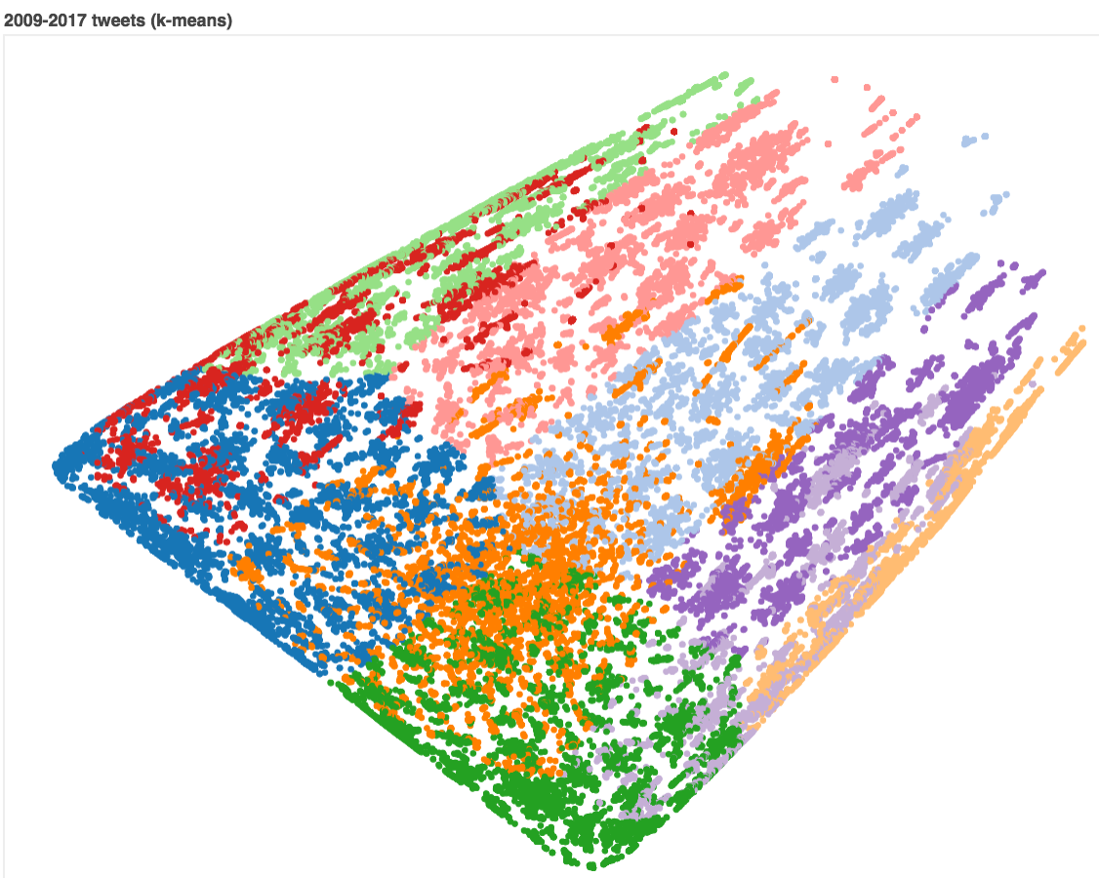

Slide 14
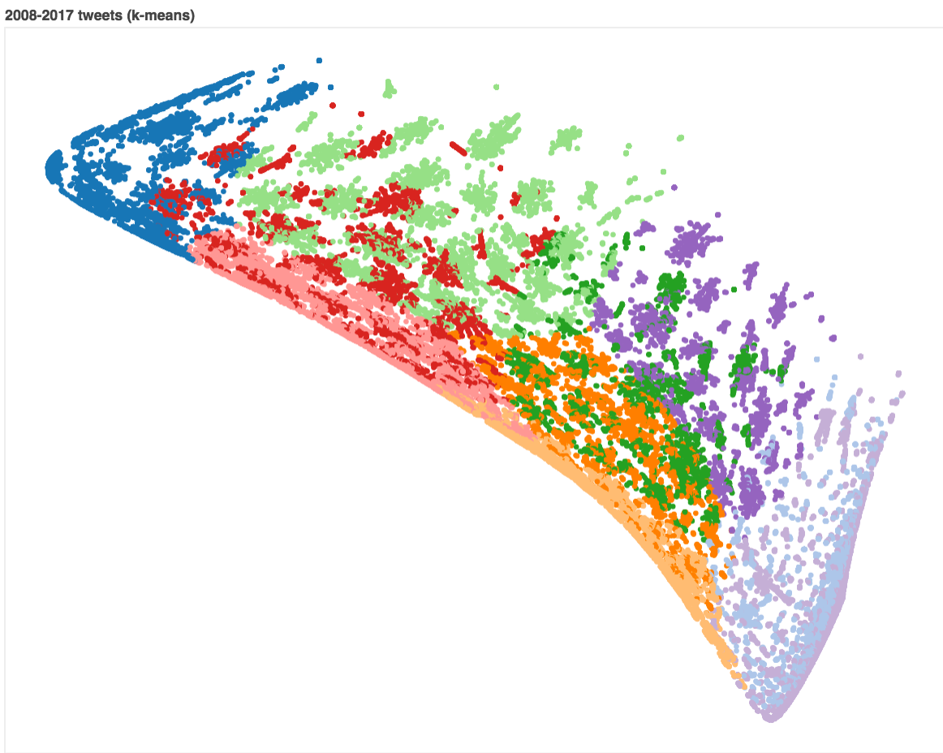
Notes:
I’m quite pleased with this chart, there are entire islands dedicated to tech-related stock news and politics. This showed a solid step towards a concept or topic-based representation of the tweets that wasn’t focused on Keywords.
The chart also showed tweets with similar topics mapped closer together.
Pay attention to how close business (grey) and marketing (dark pink) are, and how far innovation/future (orange) is away from fun and partying (purple).
Does that mean the two can’t go hand in hand? Is this graph telling us something?
We also wanted to put some of the less classical, more topical and popular approaches to NLP to the test on the collected tweets.
----- Meeting Notes (6/15/17 12:02) -----
DB Scan where you have nice clusters like this.
- a lot of points might not get included though
Chris Olah

Slide 15
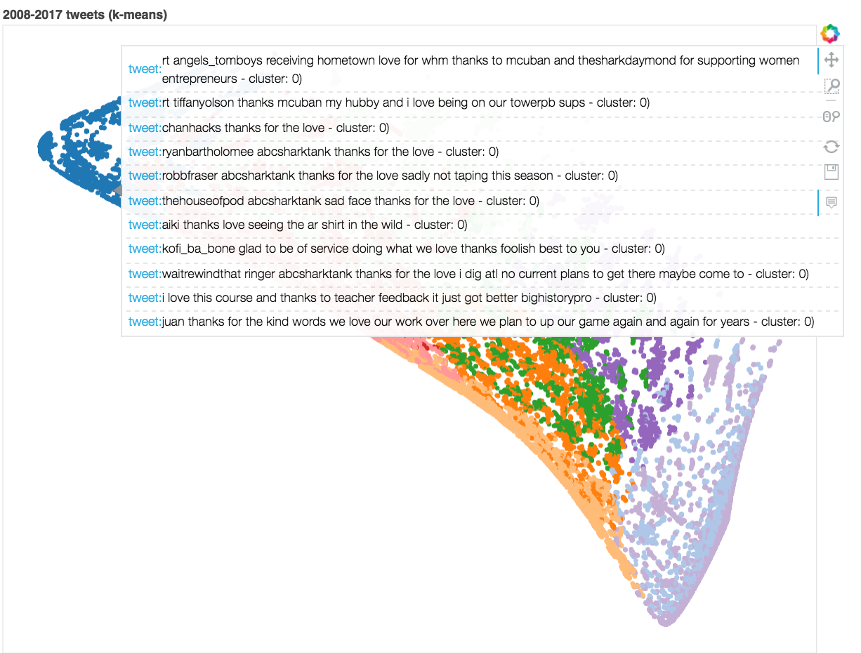
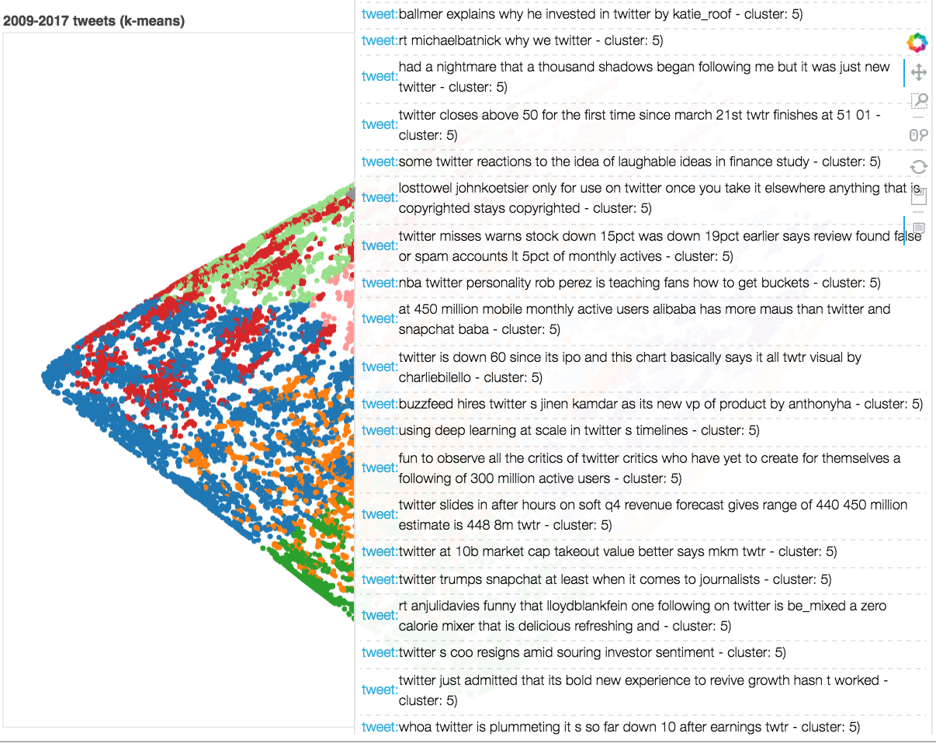
Notes:
Thanks, positive comments?

Slide 16
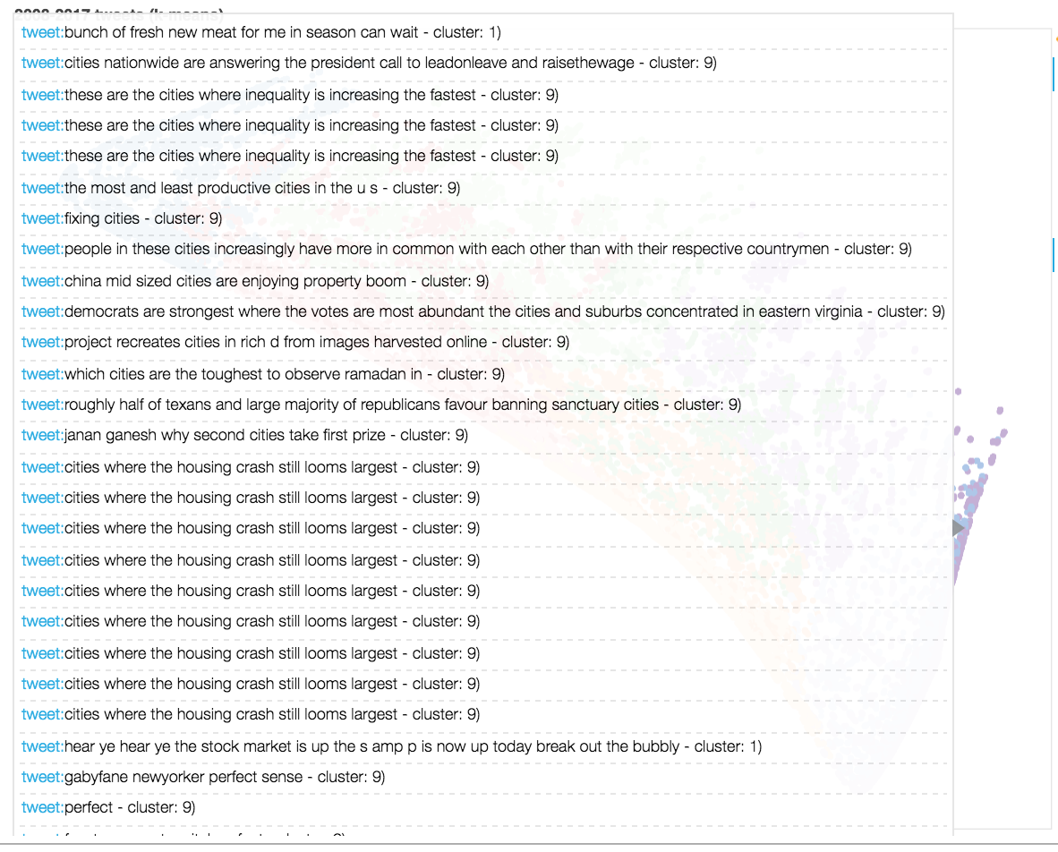

Slide 17
Identifying and cleaning “noisy” words

Slide 18
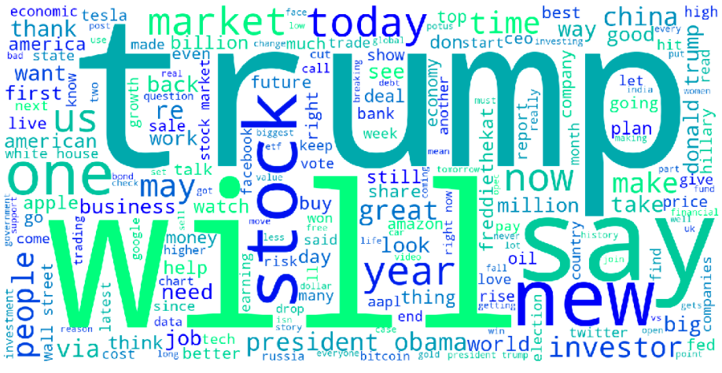
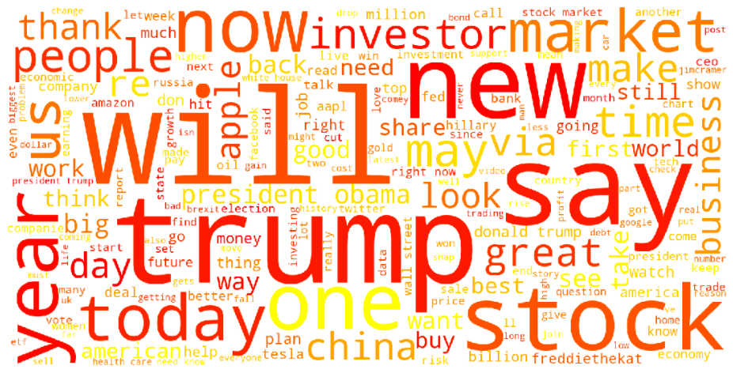
Notes:
Words that have no meaning and add no values. Taking them away should theoretically highlight the nuances in tweets that should help our models.
What are you trying to say?
What questions do they have?
What answers do you find for them?
What other questions does it inspire?
What conversations will result?
The point is that your viewers should take something away from the time they spend with your visualization.

Slide 19
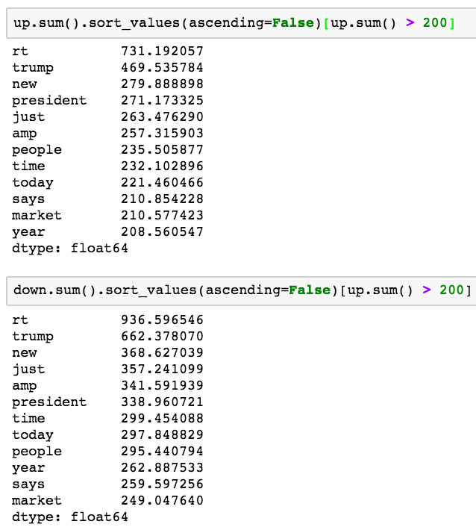
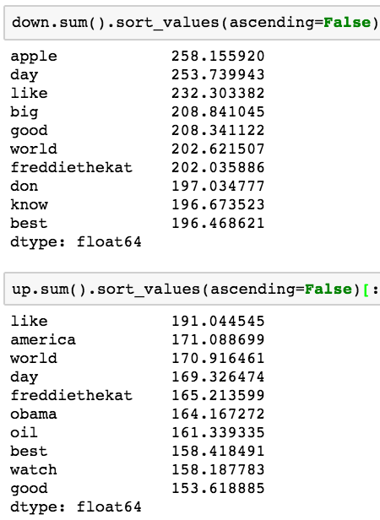
Notes:
Bigrams vs trigrams – they have to be in order (next to each other). BUT what if they don’t. MAPPING.
----- Meeting Notes (6/15/17 12:44) -----
Start with combinations, ignoring order, split tweets on white space, make a text on those, tokenize bigrams on those sets.
SPLIT WORDS
MAKE SET
COMBINATIONS - itertools - iterations.combinations(set)
distributed processing approach to make these (will take a long time)
put tweets into database and pull a tweet

Slide 20
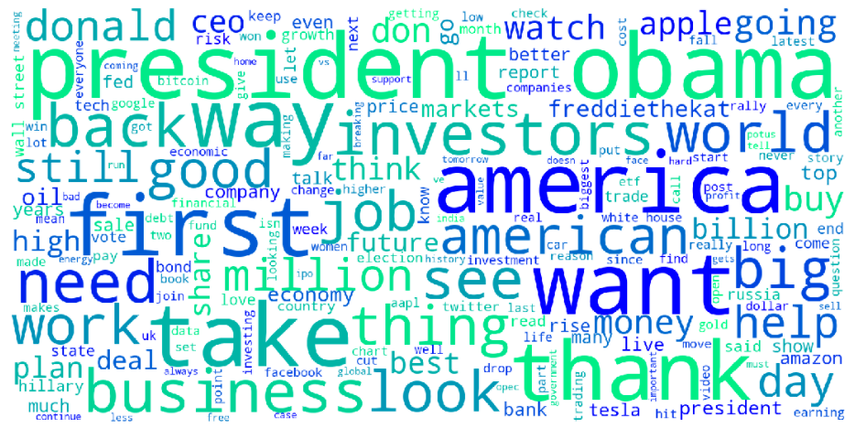
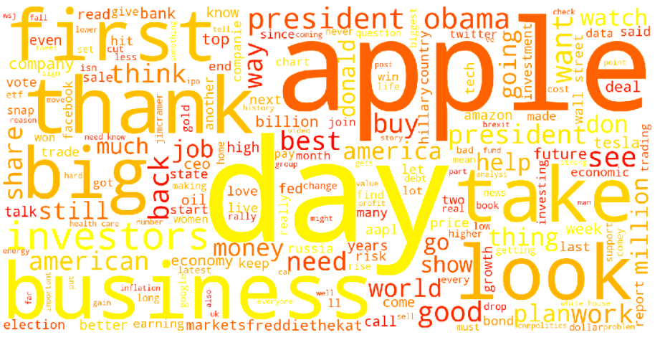

Slide 21
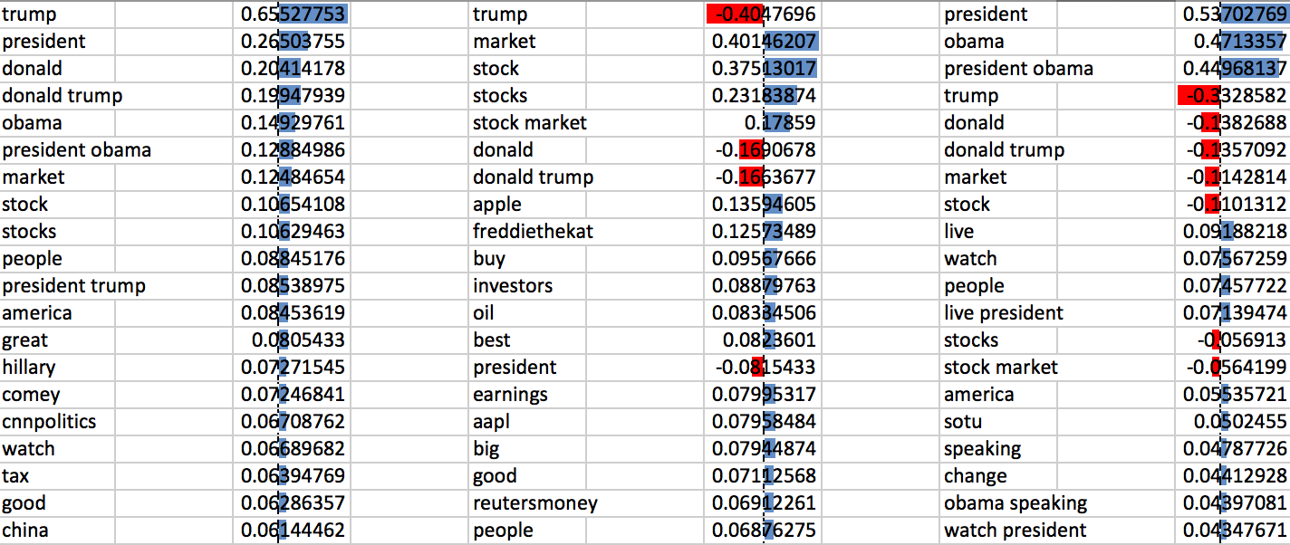
component 1 component 2 component 3
Notes:
----- Meeting Notes (6/15/17 12:44) -----
component 1 = president and market
component 2 = difference between president and market

Slide 22
Topic 1
trump
president
donald
donald trump
obama
president obama
market
stock
stocks
people
president trump
america
great
hillary
comey
cnnpolitics
watch
tax
good
china
Notes:
Topic 1 contributes to the most variance in our data.
What this means is that this “topic” makes up the most of our data – this is what our 30 thought leaders tweet most about!
What do you think topic 1 is about?
Politics & stocks

Slide 23
Topic 2
trump
market
stock
stocks
stock market
donald
donald trump
apple
freddiethekat
buy
investors
oil
best
president
earnings
aapl
big
good
reutersmoney
people
Notes:
Topic 1 contributes to the 2nd most variance in our data
What this means is that this “topic” makes up the most of our data – this is what our 30 thought leaders tweet most about!
What do you think topic 1 is about?
Stock advice

Slide 24
Topic 3
president
obama
president obama
trump
donald
donald trump
market
stock
live
watch
people
live president
stocks
stock market
america
sotu
speaking
change
obama speaking
watch president
Notes:
Topic 1 contributes to the 3rd most variance in our data
What this means is that this “topic” makes up the most of our data – this is what our 30 thought leaders tweet most about!
What do you think topic 1 is about?
Live streaming of the State of the Union!

Slide 25
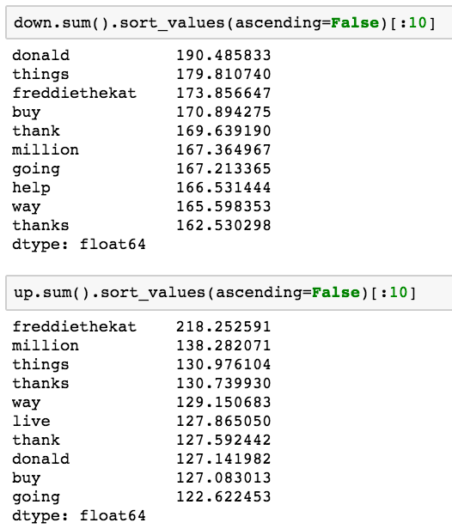
Who is freddiethekat?
Tech thought leader who tweets a lot and is at the intersection of tech and investment
Notes:
Sentiment that can be captured in news/tweets

Slide 26
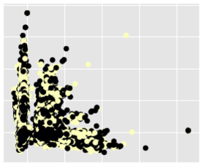
Before cleaning (raw text)
Notes:
What are you trying to say?
What questions do they have?
What answers do you find for them?
What other questions does it inspire?
What conversations will result?
The point is that your viewers should take something away from the time they spend with your visualization.

Slide 27
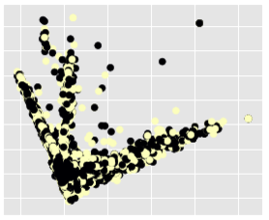
After cleaning (noisy text)
Notes:
What are you trying to say?
What questions do they have?
What answers do you find for them?
What other questions does it inspire?
What conversations will result?
The point is that your viewers should take something away from the time they spend with your visualization.

Slide 28
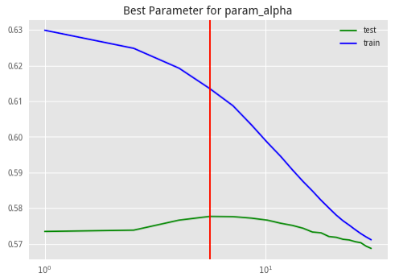
Naïve Bayes (MultinomialNB)
Test score: 0.5697644317887652
Test score (with GridSearch): 0.577674

Slide 29
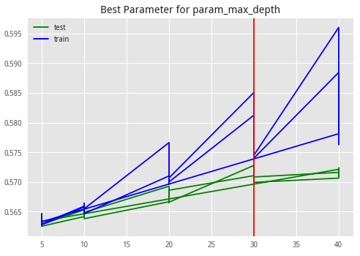
Random Forest Classifier
Test score: 0.5645223919233756
Test score (with GridSearch): 0.585068

Slide 30
Support Vector Machine (SVC)
Test score: 0.5597333678488221
Test score (with GridSearch): ???

Slide 31
KNearest Classifier
Test score: 0.5423246181724048
Test score (with GridSearch): ???

Slide 32
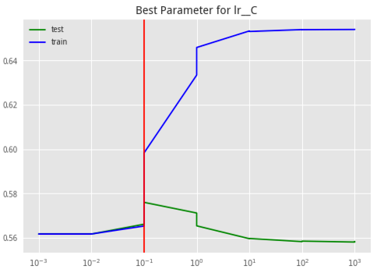
Our best model: Logistic Regression
w/o text cleaning
Test score: 0.5601863836396583
Test score (with GridSearch): 0.598307
with text cleaning
Test score: 0.5652989904219519
Test score (with GridSearch): 0.599587
Notes:
Success. Better than chance, which is really good for the market.

Slide 33
Insights
Cleaning the data got us better results
Picked better Twitter accounts and our SVD components accounted for more variance in our data (with n_components=300, we went from 11% to 29%)
When it comes to NLP, feature selection/pre-processing the the key to a good algorithm!
Simply just feeding a naïve term-frequency count of “profit” will unlikely correlate very well with stock prices
Tweets related to the State of the Union highly correlates with how the market moves
When referring to “president” – “president obama” occurs together often, but rarely “president trump” – these two words are not usually next to each other.
Notes:
Cleaning the data got us better results
Picked better Twitter accounts and our SVD components accounted for more variance in our data (with n_components=300, we went from 11% to 29%)
When it comes to NLP, feature selection/pre-processing the the key to a good algorithm!
Simply just feeding a naïve term-frequency count of “profit” will unlikely correlate very well with stock prices
To get more signal out of your data, you can:
Clean your data (especially messy data like tweets) → tokenize, extract identities (name of a company, CEO, etc.) & events (mergers & acquisitions – company A is interested in company B – hint that there might be an acquisition pending)
Deep learning → feed a lot of unstructured data into your neural network to pull information & entities
Tweets related to the State of the Union highly correlates with how the market moves
When referring to “president” – “president obama” occurs together often, but rarely “president trump” – these two words are not usually next to each other.

Slide 34
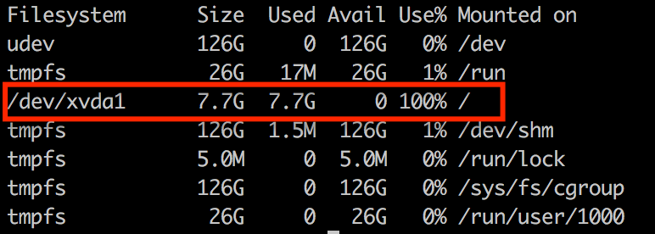
Hurdles
Yahoo Finance API down, which led to:
Web scraping Wikipedia for SP500 stock symbols and then using Google API, which did not have Adj Close, which is more accurate.
This led to a downward bias, because dividends are always being paid out, and Adj Close takes this into account to smooth the price out.
SP500 is not evenly weighted, Dow Jones is.
Solution: Scrap API. Download data from Yahoo Finance to a csv file.
CPU & RAM memory errors:
Especially for SVM-SVC and tSNE models
And for identifying high-variance features using an SVD variance code that took over 6 hours to run
Upgraded a couple times (m4.16xL), but still at over 100% CPU and 70% MEM.
Got distracted by EDA vs. Prediction
If I were to fully dive into EDA, I can pull in more data (e.g. username)
Notes:
Maxing out memory on root folder!

Slide 35
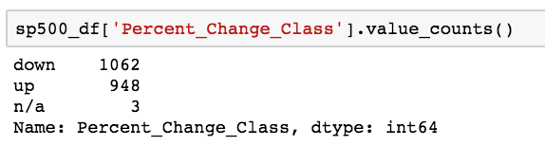
Strengths/Weaknesses
Strengths
Targeted and well-defined problem
Quality tweets (not as noisy)
Fair threshold that split up/down evenly
Weaknesses
Only shows correlation, not prediction
Relies on cleaned data (supervised)
Recommendations
More feature engineering
Clean text in different ways to see how that affects the model
Create new features (before/after Close?)
SVC did well too, but took too long to run
Build that predictive model (2 days, 5 days, etc.)
Supplemental – to make more informed decisions
Notes:
BUILD A PREDICTIVE MODEL FOR THE NEXT 2 DAYS
Can I look at these tweets before the market opens and predict what happens?
Pull new tweets from these 30 people to make a new test set → use my encoder to see if tweets predicted stocks correctly
Identified the 30 people to listen to
Use LSA to find more people to listen to (who’s tweets are similar – influencers)
Ensembling
Building ensemble models based on chunking hours of the day to create new features (is NY market open? China? Day of week?)
Look at tweets (time) if it went out before Close
Pull in timestamp data (0-24)
See what the accuracy was in the morning vs after market has closed - does my model accuracy change?
Intuition: if tweets were after market closed, thats why scores are so good?
Chunk my input data (X, y grouped together) into a couple of SMARTLY chosen chunks and build a different model for each one.
One model for: is it morning and NYC hasnt opened yet?
One model for: market is open (morning), (evening), close.
COMPLETELY SPLIT YOUR X's and Y's BEFORE doing anything to it. Is Twitter reactionary or causal? Do you get a higher/lower score?
----- Meeting Notes (6/15/17 12:44) -----
SelectFromMOdel
SelectKBest
RFE

Slide 36
Inspiration/where credit’s due
Data Skeptic Podcast (episode with Delia Rusu, esimating stock price correlations using Wikipedia: https://www.youtube.com/watch?v=B9sIS2-_sv4)
Analyzing Tweets from Web Summit 2015:
http://blog.aylien.com/analyzing-tweets-from-web-summit-2015-semantic/

Slide 37
Tools & Libraries
pyMongo
Tweepy
regex
TF-IDF
SVD
t-SNE
Bokeh
Sci-Kit Learn
GridSearchCV
Pipeline
StratefiedShuffleSplit
train_test_split
MultinomialNB
LogisticRegession
RandomForestClassifier
SVC
KNeighborsClassifier
Notes:
Sentiment that can be captured in news/tweets

Slide 38
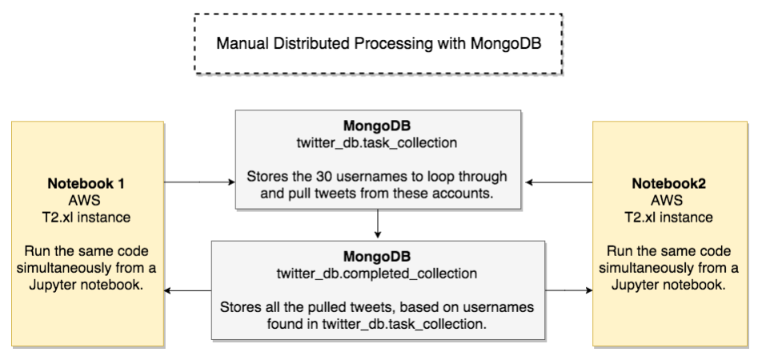
Manual Distributed Processing with MongoDB
Notes:
What are you trying to say?
What questions do they have?
What answers do you find for them?
What other questions does it inspire?
What conversations will result?
The point is that your viewers should take something away from the time they spend with your visualization.

Slide 39
Challenge Accepted
BUILD A PREDICTIVE MODEL FOR THE NEXT 2 DAYS
Can I look at these tweets before the market opens and predict what happens?
Pull new tweets from these 30 people to make a new test set → use my encoder to see if tweets predicted stocks correctly
Identified the 30 people to listen to
Use LSA to find more people to listen to (who’s tweets are similar – influencers)
Ensembling
Building ensemble models based on chunking hours of the day to create new features (is NY market open? China? Day of week?)
Look at tweets (time) if it went out before Close
Pull in timestamp data (0-24)
See what the accuracy was in the morning vs after market has closed - does my model accuracy change?
Intuition: if tweets were after market closed, thats why scores are so good?
Chunk my input data (X, y grouped together) into a couple of SMARTLY chosen chunks and build a different model for each one.
One model for: is it morning and NYC hasnt opened yet?
One model for: market is open (morning), (evening), close.
COMPLETELY SPLIT YOUR X's and Y's BEFORE doing anything to it. Is Twitter reactionary or causal? Do you get a higher/lower score?

